Slide 1
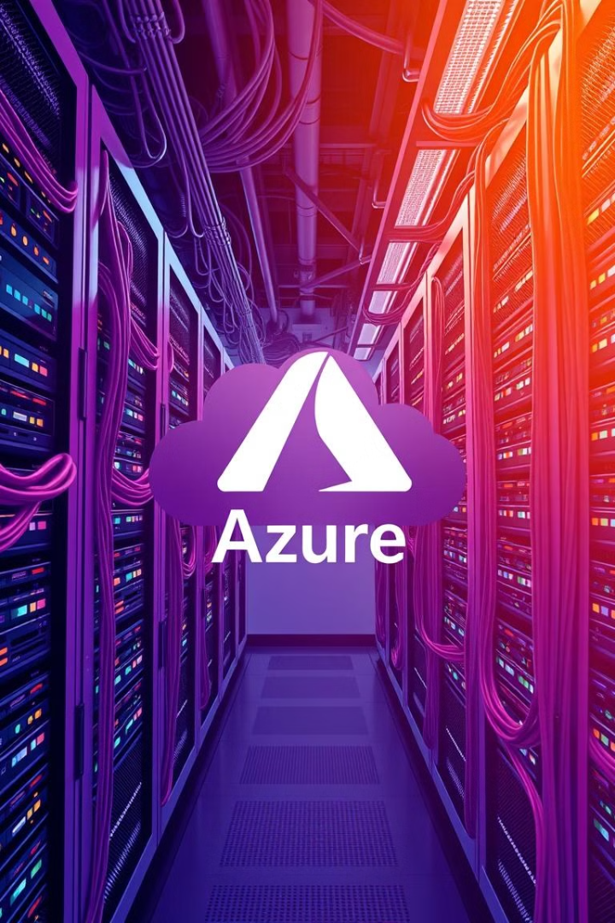
Case Study on Microsoft Azure
A deep dive into Azure's features, architecture, and business impact.
By:-
Sahil Mate
TE-B
Roll No. 39046
YG

Slide 2
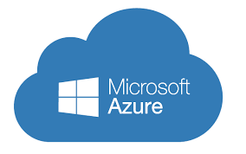
Introduction
Cloud Computing Platform
Broad Range of Services
Microsoft Azure is a comprehensive cloud computing platform offered by Microsoft.
Azure offers a wide variety of services, including compute, storage, databases, AI, networking, and more.
Scalability & Efficiency
Businesses can efficiently deploy applications and services, scaling their infrastructure as needed.

Slide 3

Objective
Functionality & Architecture
Business & Developer Support
Gain a clear understanding of Azure's functionalities and underlying architecture.
Evaluate how Azure empowers businesses and developers with its capabilities.
Analysis & Insights
Analyze the advantages, disadvantages, and limitations of Azure.

Slide 4
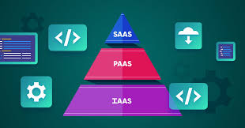
Key Features
Comprehensive Solutions
Diverse Capabilities
Features include virtual machines, AI, DevOps, and support for multiple programming languages.
Azure provides Infrastructure-as-a-Service (IaaS), Platform-as-a-Service (PaaS), and Software-as-a-Service (SaaS) solutions.
Global Reach & Availability
Microsoft Integration
Seamless integration with popular Microsoft products like Windows Server and SQL Server.
High availability is ensured through a global network of data centers.

Slide 5
Azure Architecture
Compute
Storage
Networking
Security & Identity
Virtual Machines (VMs), Azure Kubernetes Service (AKS), Azure Functions.
Blob Storage, Azure Files, Table Storage.
Virtual Network (VNet), Load Balancer, Azure DNS.
Azure AD, Key Vault, Security Center.
Development Tools: Azure DevOps, Visual Studio, Logic Apps.

Slide 6
Advantages & Disadvantages
Advantages
Disadvantages
Strong integration with Microsoft tools, hybrid cloud support, advanced AI and machine learning capabilities, enterprise-grade security.
Complex pricing structure, requires expertise for optimal setup, limited third-party integrations compared to AWS.

Slide 7

Limitations
Regional Availability
Learning Curve
Some Azure services have limited availability in certain regions.
Non-Microsoft users may face a steeper learning curve when adopting Azure.
Cost Management
Managing costs effectively can be challenging due to the complexity of the pricing structure.

Slide 8
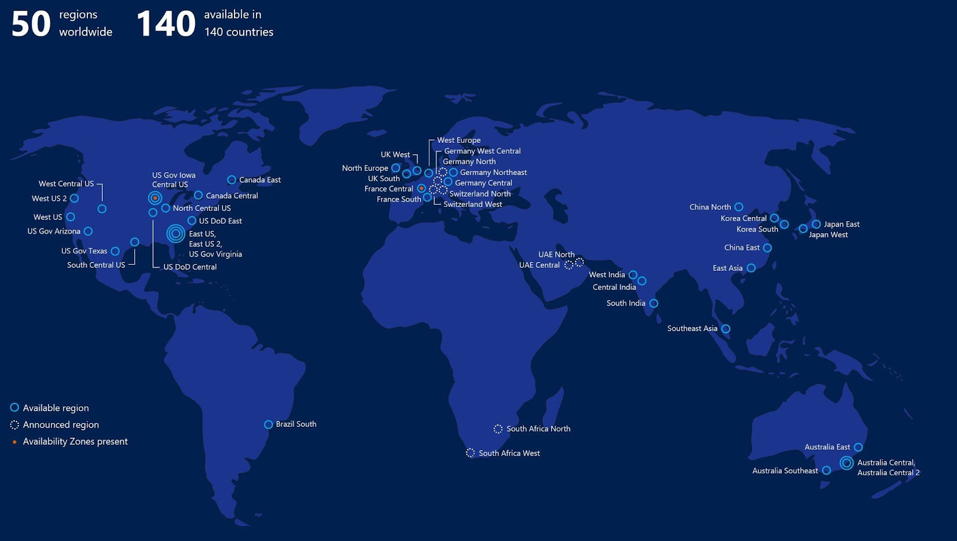
Azure Data Centers & Global Reach
Extensive Global Presence
Data Redundancy & Recovery
Low Latency & High Availability
Azure operates in over 60 regions worldwide, ensuring global coverage.
Data redundancy and disaster recovery strategies are implemented across multiple locations.
Provides low latency and high availability for users worldwide.

Slide 9
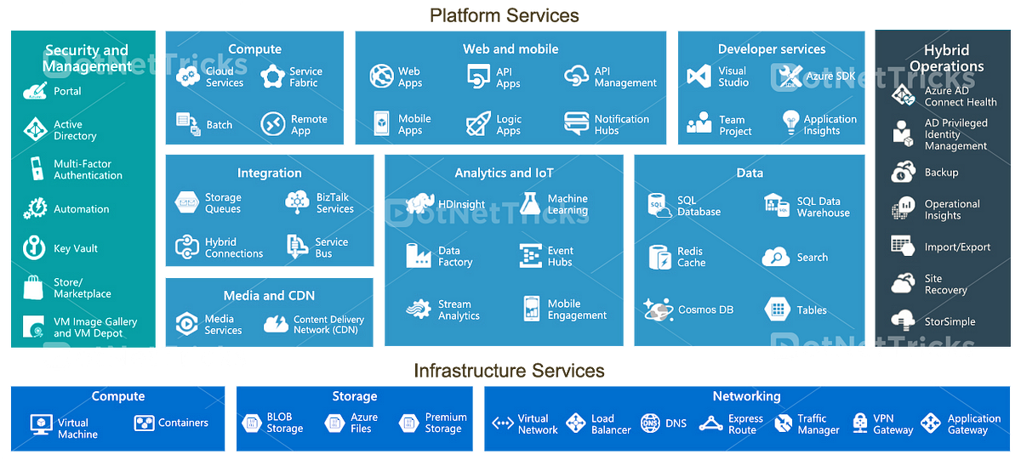
Azure Services Overview
AI & Machine Learning
Internet of Things
Cognitive Services, Azure ML.
IoT Hub, Azure Sphere.
Security & Compliance
Defender for Cloud, Firewall.

Slide 10
References
Microsoft Azure Official Website: https://azure.microsoft.com
Microsoft Azure Documentation: https://learn.microsoft.com/en-us/azure/
Microsoft Cloud Blog: https://cloudblogs.microsoft.com/

